Slide 1

EFSUMB
EUROPEAN FEDERATION OF SOCIETIES FOR ULTRASOUND IN MEDICINE AND BIOLOGY
REPORT FROM HON TREASURER Christian Jenssen
BOARD OF DELEGATES’ MEETING EUROSON 2019 in Granada
29 May 2019

Slide 2
Income
 | GPB (£) | Euro (€): average rate 1.136
Membership fees 19,497 members from 29 national societies (2017: 21,621) plus: Germany 562, Poland 150, Romania 142, new Georgia 20 minus: 2,904 SGUM minus: 94 other countries | 120,733 GBP (2017: 133,418) expected: 133,463 GBP plus: Germany, Poland, Romania, Georgia = appr 5,414 GBP minus: appr 18,000 GPB minus: appr 580 GPB | 136,433 Euro
Sponsorship | 49,741 (2017: 50,977) | 56,506
Publishing income (e.g. ECB) | 0 (2017: 2,800) | 0
Endorsed courses and schools | 4,399 (2017: 3,886) | 4,997
Investment income | 1,940 (2017: 3,010) | 2,204
TOTAL | 176,813 £ (2017: 194,091) | 200,860 € (2017: 221,456)
- 11,650

Slide 3
Expenditures: stable (but less gains on exchange GBP ./. Euro)
 | GPB (£) | Euro (€): average rate 1.141
Office overheads, administration | 46,124 (2017: 48,546) | 52,397
Subscription WFUMB | 23,238 (2017: 23,584) | 26,398
EFSUMB newsletter | 4,252 (2017: 3,619) | 4,831
Euroson schools, congresses & similar | 45,447 (2017: 34,994) | 51,628
Guideline meetings and similar | 47,299 (2017: 49,215) | 53,732
Website development | 13,296 (2017: 15,547) | 15,104
Educational webinars | 2,124 (2017: 4,293) | 2,413
TOTAL expenditures | 181,780 (2017: 179,798) | 206,502
Gains on exchange* | 6,601 (2017: - 25,830) | 7,499
TOTAL expenditures and losses | 175,179 (2017: 153,968) | 199,003
* Related to changes in exchange rates GPB/Euro.
EFSUMB is required to state their finances in sterling as they are a UK charity, but most financial transfers are made in Euro

Slide 4
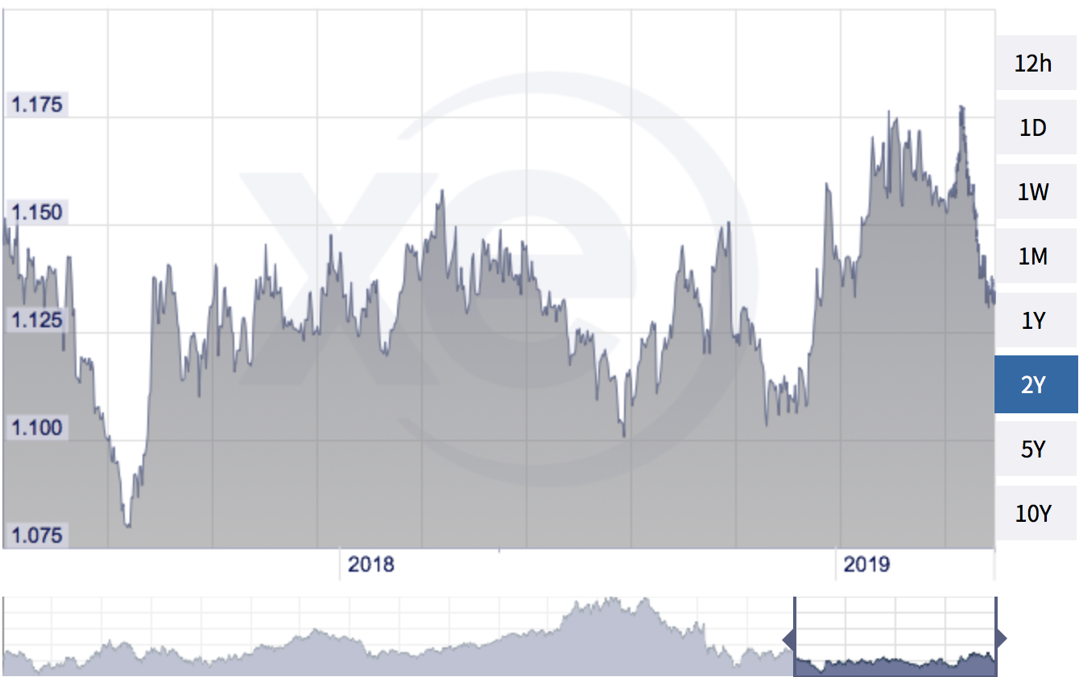
Explanation for gains and losses at exchange: GBP to Euro Chart 2018
Jan 01, 2017: 1.17
Dec 31, 2017: 1.13
April 22, 2017: 1.19
Aug 29, 2017: 1.08
Jan 01, 2018: 1.125
Dec 31, 2018: 1,105
April 16, 2018: 1.16
Dec 23, 2018: 1,11
Differences between the opening and closing GBP/EURO rates
2017: 0.04
2018: 0.02
https://www.xe.com/currencycharts/?from=GBP&to=EUR&view=2Y

Slide 5
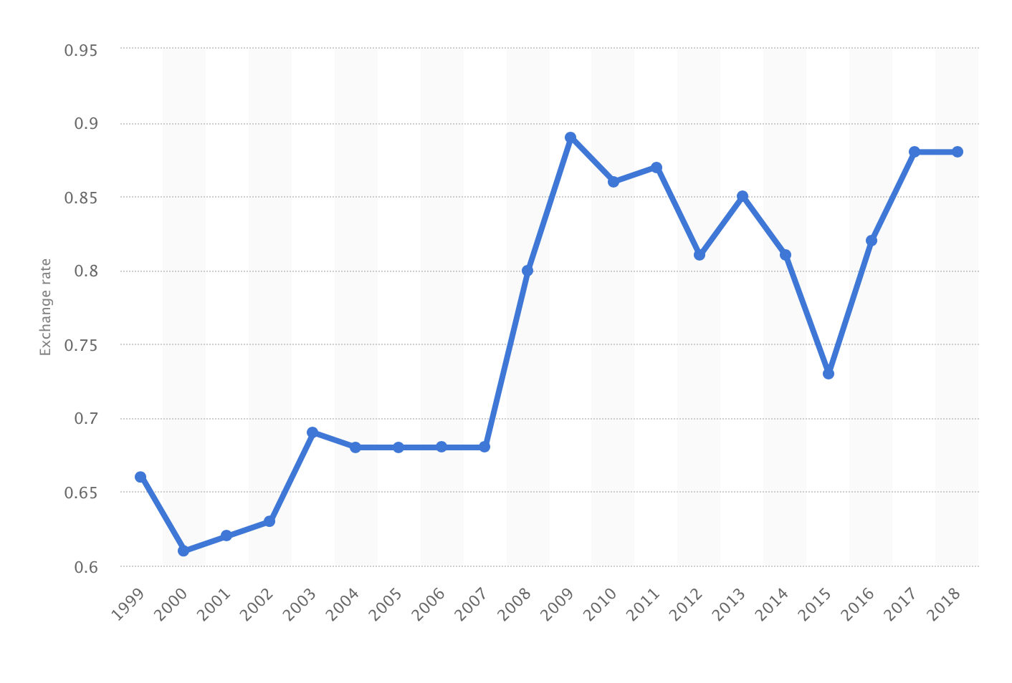
Euro to GBP Chart – 1999 – 2017 (© Statista 2018)
Average
2014: 0.81/ 1.23
2015: 0.73/ 1,37
2016: 0.82/ 1,22
2017: 0.88/ 1,14
2018: 0.88/ 1,14
https://www.statista.com/statistics/412806/euro-to-gbp-average-annual-exchange-rate/

Slide 6
Expenditures – „travel & accomodation“ 2018
 | Euro
One physical ExB meeting (Poznan) | 947
EPSC/Publications committee/ joint meeting | 4651
ECMUS | Electronic meetings
ESC | Electronic meetings
EUROSON 2018 | 11,179 (accomodation & flights for all committee members, past-presidents)
ECR 2018 | 602
SRUMB 2018 | 867
DLT Basel 2018 | 1444
* Related to changes in exchange rates GPB/Euro.
EFSUMB is required to state their finances in sterling as they are a UK charity, but most financial transfers are made in Euro

Slide 7
Balance sheet – 2016 - 2018
 | 2018 | 2017 (GBP) | 2016 (GBP)
Total expenditures | 175,179 | 153,968 | 186,983
Total Income | 176,813 | 194,091 | 207,685
- Membership fees and similar | 120,733 | 134.059 | 122,482
- CEUS, Euroson Schools, Congress | 54,140 | 54,863 | 80,619 (incl. CEUS GL)
NET Income before gains/ losses | 1,634 | 40,123 | 20,702
Gains/losses on investments | - 2,712 | - 1,536 | 10,103 (fonds mature)
NET income | - 1,078 GBP | 38,587 GBP | 30,805 GBP
 | at Dec, 2018 | at Dec 31, 2017 | at Dec 31, 2016
Tangible assets | 871 | 1,162 | 1,549
Creditors (amounts falling due per 1 year) | (53,203) | (43.982) | (43.384)
EFSUMBs NET assets | 453,587 GBP (x 1,1092 = 503,119 €) | 454,665 GBP (x 1,1259 = 511,907 €) | 416,087 GBP (x 1,1733 = 488,195 €)

Slide 8
EFSUMB Budget for 2020 (Euro)
INCOME
Membership fees (x 7 €) 15,265* | 106,855 + 5,000 (individual)
EUROSON Schools | 3,000
Endorsed Courses | 1,500
EUROSON Congress | 2,500
Investments | 2,000
Industry Sponsorship Webinars | 12,000
Bracco CEUS School Sponsorship | 36,000
Bracco CEUS Recording | 6,000
Bracco Webinar Sponsorship | 20,000
Industry non-CEUS Webinars sponsorship | 12,000
Total ECB sales | 500
TOTAL INCOME | 195,355
EXPENDITURE
WFUMB Dues (x1.5 USD) 15,265 | 20,743
EFSUMB attendance at other congresses | 5,000
Meetings, Executive Bureau | 5,000
Meetings, EFSUMB Committees | 20,000
Prizes | 5,500
CEUS Schools and Recordings | 38,000
Webinars | 48,000
Website maintenance | 20,000
Guidelines Consensus Meetings POCUS | ?
Office overheads, administration | 59,000
Loss on exchange | 3,000
TOTAL EXPENDITURE | 205,243
* Based on 33% cut-off rule and including
100 individual members (each 50 Euro)
Balance | - 9,888

Slide 9
Problems & Prospects
Problems:
Unpredictable GBP – Euro exchange rates
Majority of income and expenditure and the banking account is in Euro
Final audited accounts are in GBP as EFSUMB is an UK charity
Unpredictable financial consequences of BREXIT
A 33% cut-off rule will reduce income by 29,624 Euro, 25% cut-off by 40,222 Euro
Interest in individual membership is unpredictable
(Desirable) decrease in sponsorship for Guidelines (due to conflicts of interest)
Prospects:
Reduction of expenditures for travelling and guideline meetings (goToMeeting, online voting)
Consolidation of income from Euroson schools, endorsed courses and webinars
Exploitation of new sources of income:
individual membership for countries without national societies
fees for particular Website contents and Webinars for non-members

